Slide 1


M-Project

Slide 2
Our team
Scrum trainer: Nevena Pavlova
C++ developer: Teodor Angelov
Front-end developer: Alexander Yanev
Code checker: Petar Borisov
Code checker: Kristian Neykov

Slide 3
The process
We considered the idea about our project!
We have allocated the tasks.
We have set a deadline for completing the tasks.
We made final changes to the code.

Slide 4




We used

Slide 5
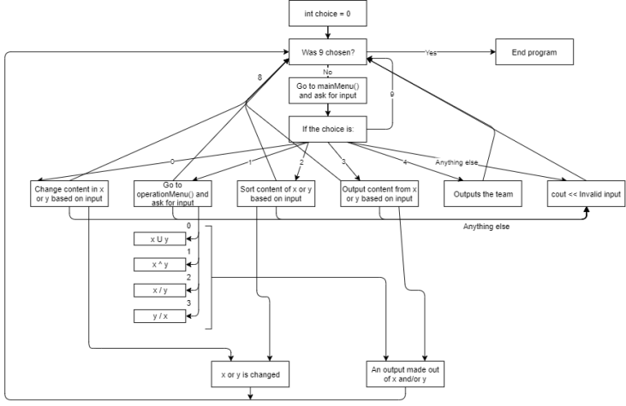
Diagram of the program

Slide 6

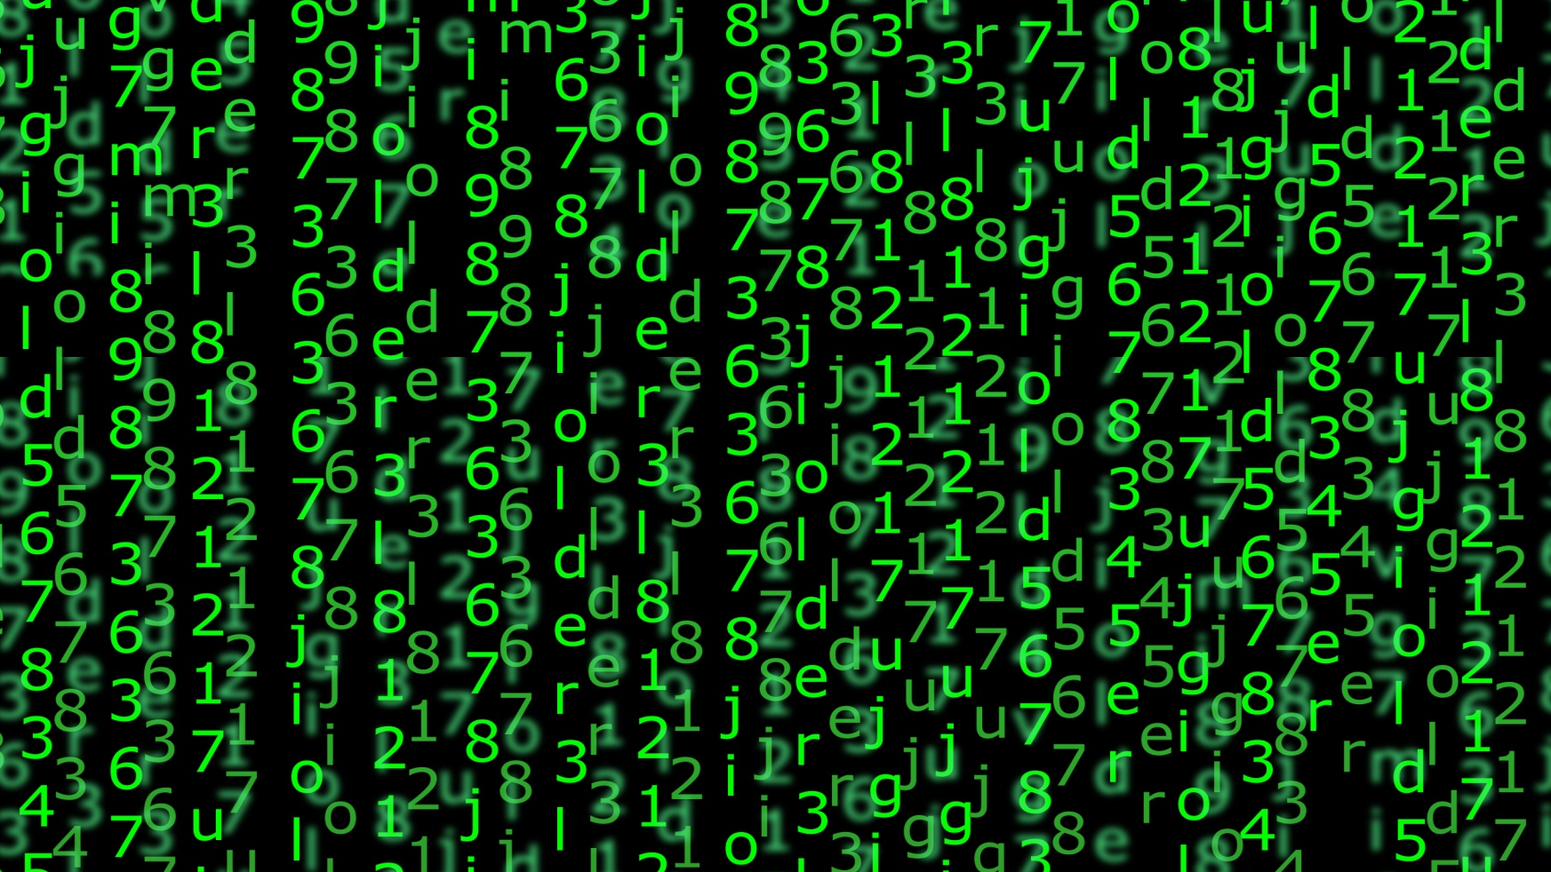
Now it's time for our program

Slide 7



Slide 8

Thank you for the attention!

